Slide 1

Comprehensive Study of Metaheuristic Algorithms for Optimal Sizing of Multiservice BESS
By: Joakim Ginste
Supervisor: Felipe Ignacio Gallardo
Examinator: Justin NingWei Chiu

Slide 2
Introduction
Energy storage will play an important role in the future energy market.
Due to more instability being introduced by variable energy production sources.
Can be used for power stability
Monetary value can be gained by energy arbitrage
This study will investigate state of the art methods for optimal sizing of battery energy storage system (BESS)

Slide 3
Background
Energy arbitrage and Peak shaving
Energy storage can profit of these methods
Optimization algorithms
Minimize or maximize a specific variable by changing parameters
Notes:
Energy arbitrage and Peak shaving: Two different methods to obtain monetary value from the electricity market, or savings can be made.
Optimization Algorithm: Maximizing or minimizing a specific parameter by changing inputs from a search space
Image of peak shavings?

Slide 4
Literature study
Goal: Find state of the are techniques for optimal sizing of energy storage.
Found methods:
Multi-pass dynamic programming (1995)
Meta-Heuristic
Genetic algorithm (GA)
Firefly algorithm (FF)
Particle swarm optimization
Artificial bee colony, Bat algorithm, Teacher-Learner optimization, and many more.
Most studies only focuses on only optimizing for Energy storage capacity and not power
Notes:
Shortly present what the literature study found.
Starting with multi pass programing
Then more and more meta-heuristic algorithms are started to be used
Then they are starting to compare them to each other
But GA have been used for a long time and is still seen as a viable option
FF was seen as one of the more effective one when Khan.et.al compared 6 different algorithms.
Most studies focused only on energy capacity not power capacity.
FF and GA was chosen to be looked more into as they were seen as state of the art

Slide 5
Meta heuristic algorithms
“Meta” – Greek meaning “after”, “beyond”, or “along with”
“Heuristic” – Greek meaning “to discover”
Meta-heuristic algorithms trade accuracy for computational performance
Can be used on many different problems
Won’t guarantee the exact solution
Low computational times
Uses a fitness function to compare solutions

Slide 6
Objective & research questions
The objective of this study is to investigate what the state-of-the-art techniques for optimal energy storage sizing is. Thereafter, apply two of these to a case study to compare the results.
Research questions:
What difference and similarities can be found when comparing GA and FF when applied to a case study?
Which is most effective in finding converging results?
Which is overall best for the given case study?
Which is most time effective?

Slide 7

methodolgy
Case study:
3 different cases
2 different objective functions (LCOS) and (NPV)
Testing algorithms at different number of iterations [5, 10, 25, 50, 100, 200]
Running each case and number of iteration 10 times, to find Standard deviation

Slide 8
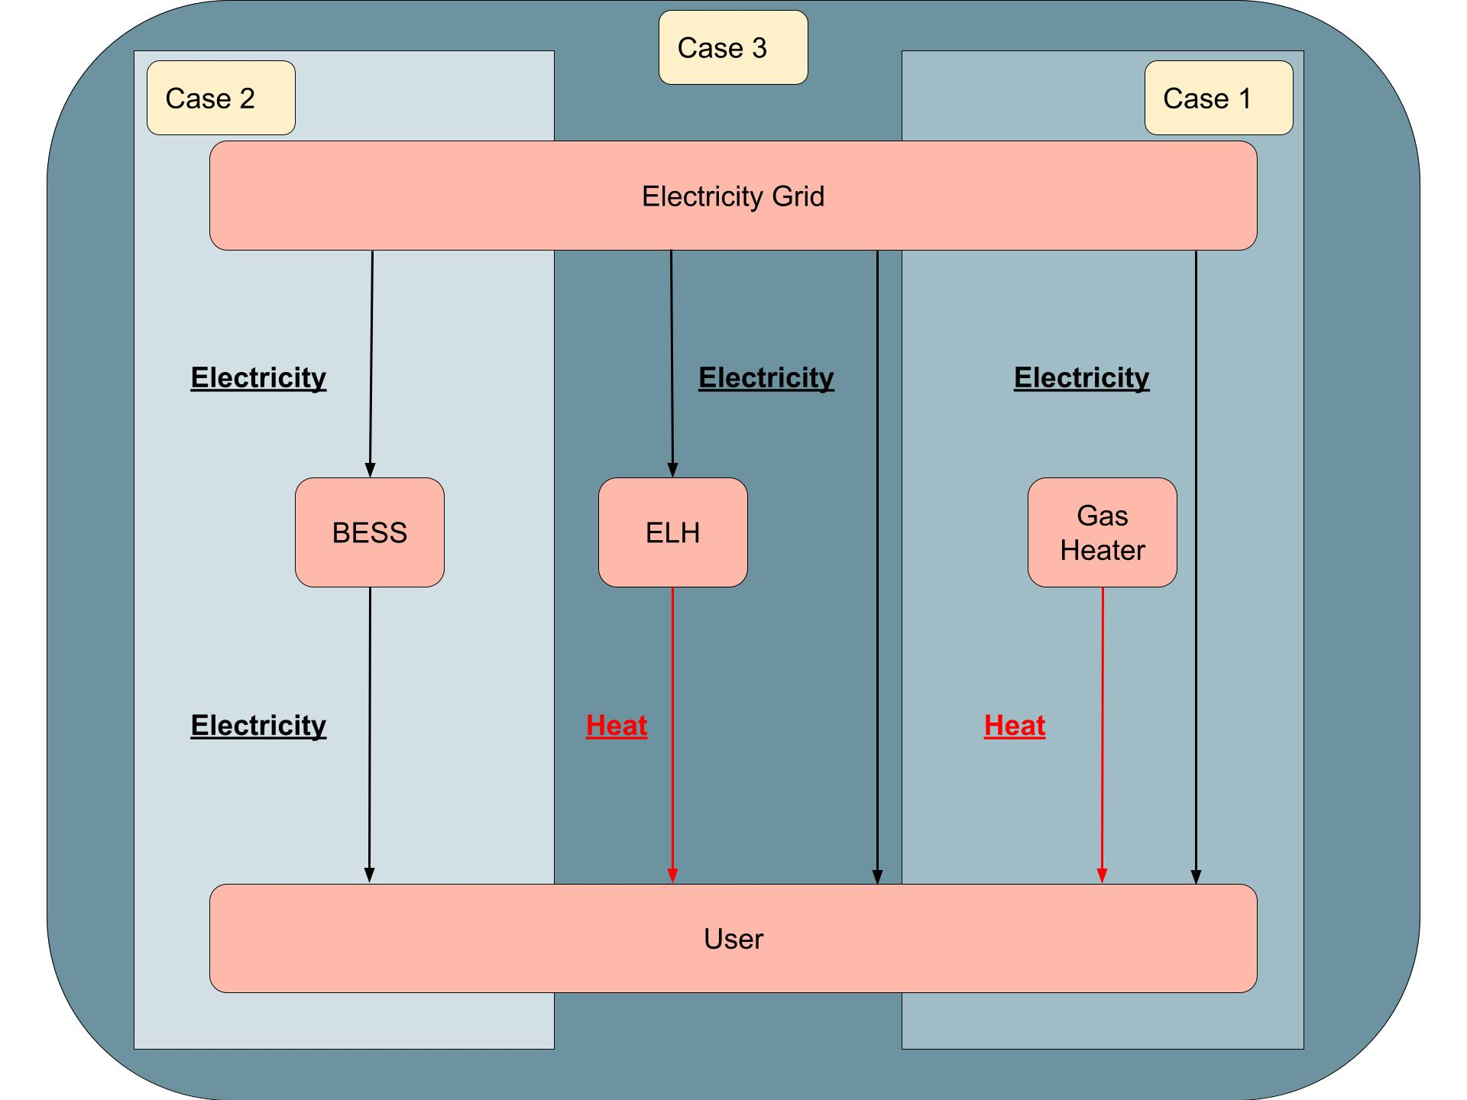
System model
Case 1: Base case, No BESS or Electrical heater (ELH)
Case 2: Optimize for BESS size
Case 3: Optimize for BESS and ELH size
Notes:
Explain ELH case 3 here:

Slide 9
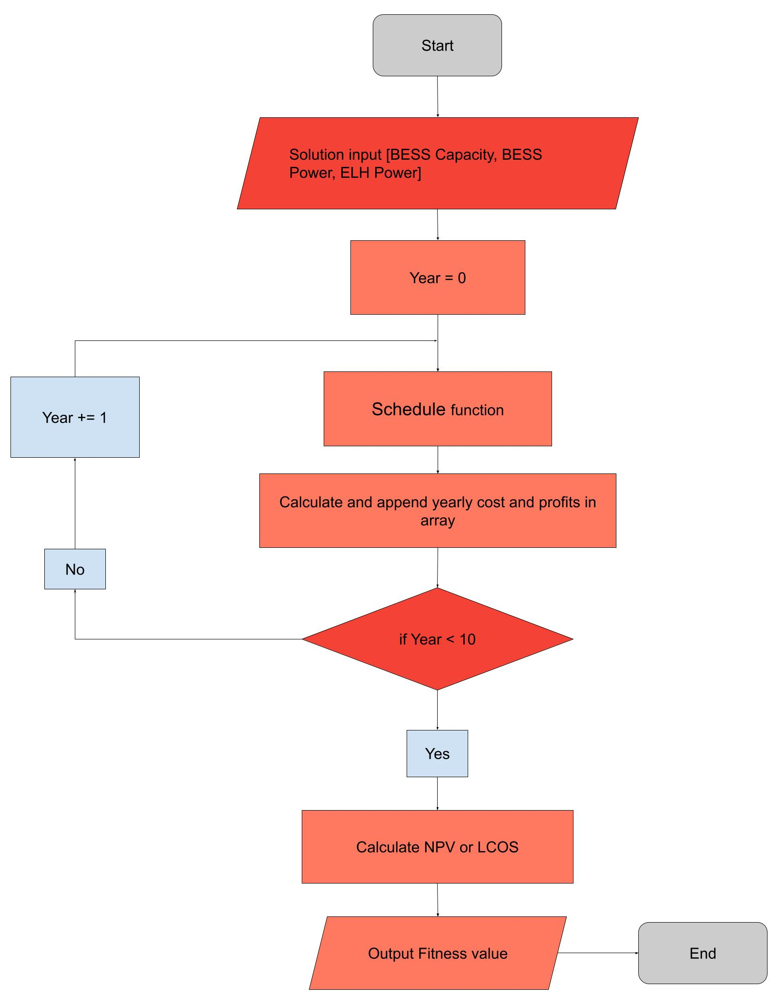
Flowchart of fitness function
Flowchart of fitness function used in both Meta-heuristic algorithms
Uses fitness values to compare how different solutions to each other
Solutions structure:
Case 2: [BESS capacity, BESS power]
Case 3: [BESS capacity, BESS power, ELH power]

Slide 10
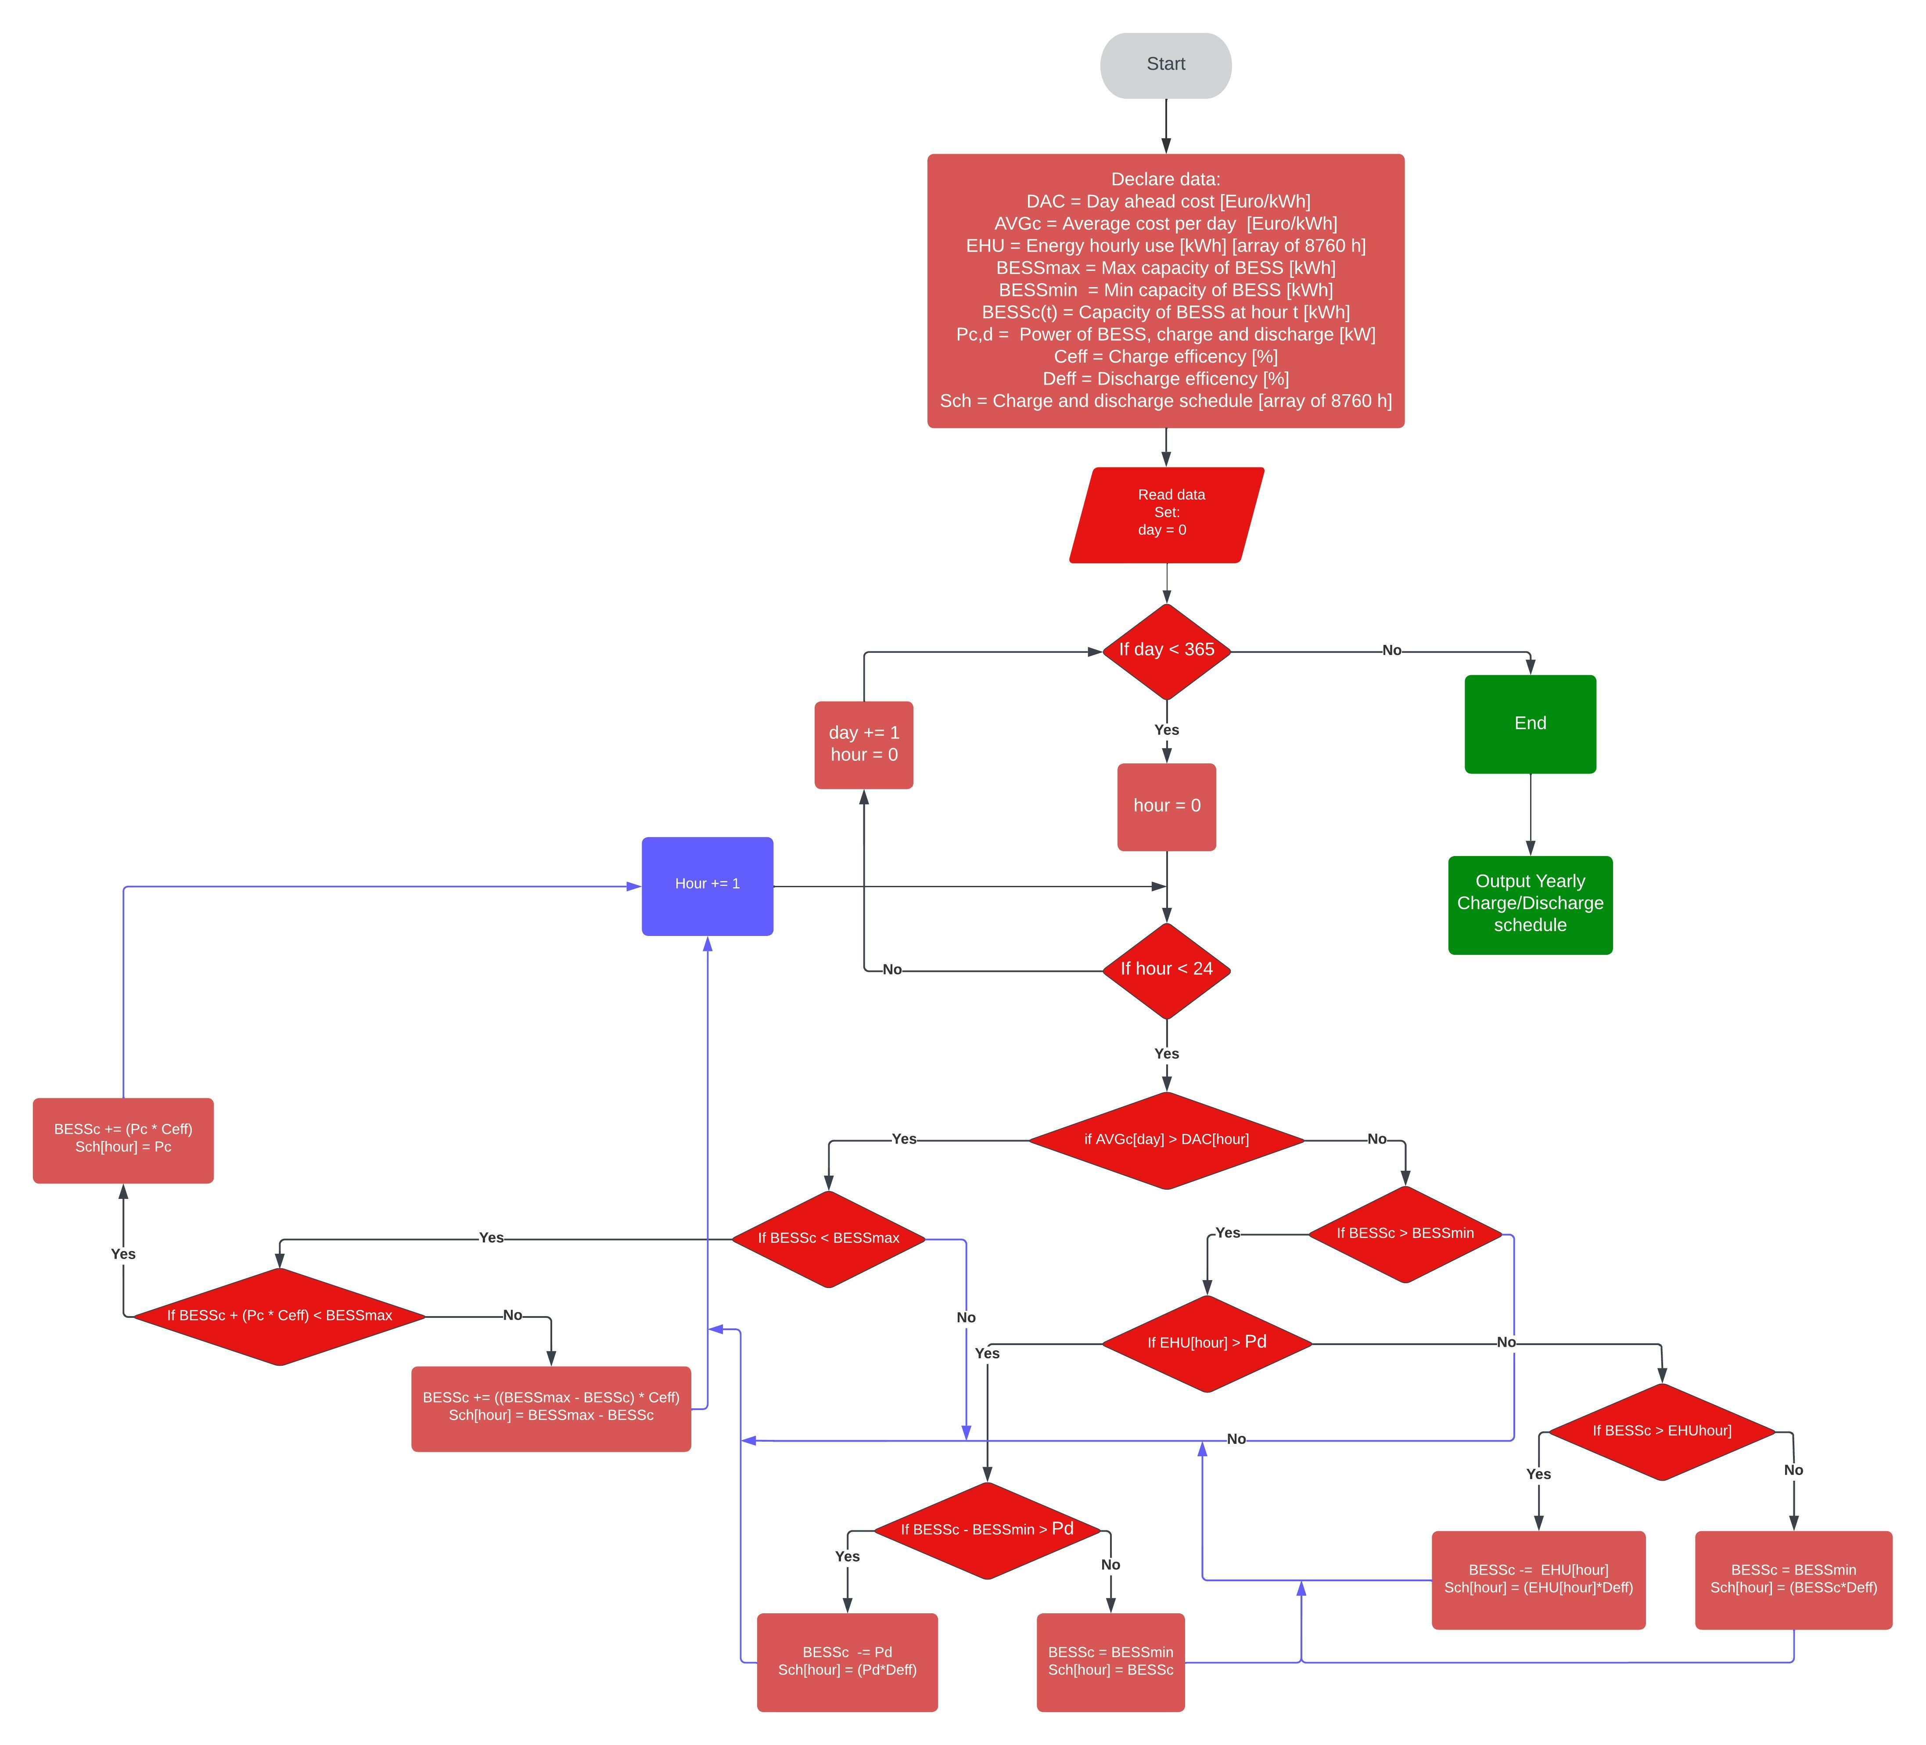
BESS charge/discharge schedule
Main idea:
Charge BESS (buy) when:
Hourly cost < Daily average cost
Discharge (sell) when:
Hourly cost > Daily average cost
Edge cases -> complicated flowchart
Notes:
Explain with two lines, be quick

Slide 11
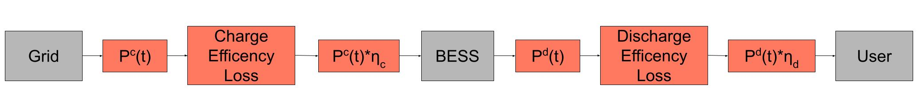
Bess charge/discharge equations
Charge : BESS_{c}(t + 1) = BESSc(t) + P_{c}(t) ∗ η_{c}
Discharge : BESS_{c}(t + 1) = BESSc(t) − P_{d}(t) ∗ η_{d}
0 ≤ P_{c}(t) ≤ P_{c,max}
0 ≤ P_{d}(t) ≤ P_{d,max}
BESS_{min} ≤ BESS_{c}(t) ≤ BESS_{max}
BESS(t = 0) = 0 Optimization starting with no electricity in BESS
Figure: Charge/Discharge flowchart
Notes:
Charge: Next timestep of BESS capacity is equal to current BESS capacity plus power P times the efficiency paramteter eta for charging
DIscharge: same but for discharge
Maximum discharge and charging power limits what can be charged/discharge to the BESS
A minimum and maximum value for the BESS capacity
State of charge of the BESS, limitations, equations (rules) is implemented into the optimization/model

Slide 12
Objective functions
Objective function is to either:
Maximizing for Net present value (NPV) or:
Minimizing for Levelized cost of storage (LCOS)
Optimizing parameters:
Case 2: BESS capacity and power
Case 3: BESS capacity and power as well as ELH power
Notes:
Objective functions, main goal to optimize for NPV or LCOS

Slide 13
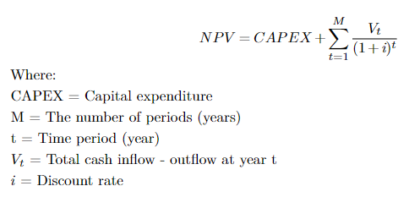
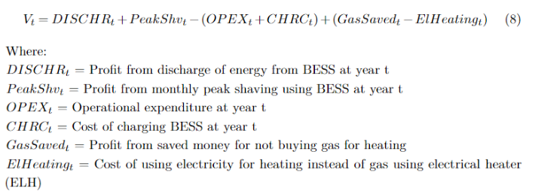
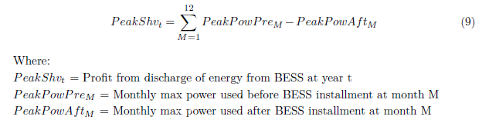
Net present value (NPV)
Notes:
NPV: Depends on CAPEX, Cash inflows and outflows and lastly the discount rate
Used to determine the current value of all future cashflows including the initial investment (CAPEX)
Bullets points explain the NPV
Why use NPV?
Equations for npv in end of presentation

Slide 14
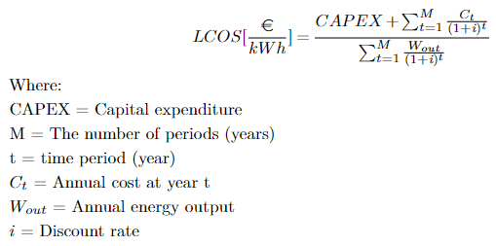
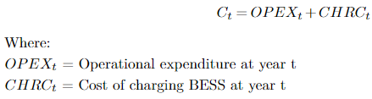
Levelized cost of storage
Notes:
The CAPEX is only regarding the CAPEX for the BESS for both cases and excludes the
cost of installing the ELH for case 3.
For OPEXt it includes both the fixed and variable operational cost, and for case 3 it
includes the OPEX for both the BESS and ELH, whilst for case 2 it only include the OPEX
for BESS.
Bulllets points showing the value of using the LCSO and what it is

Slide 15
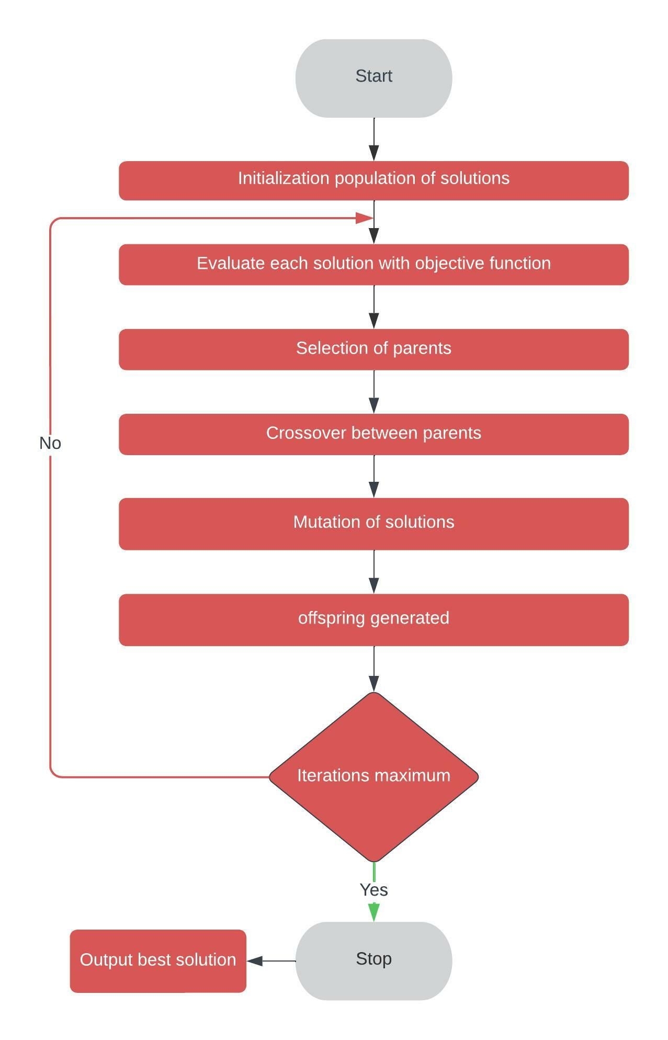
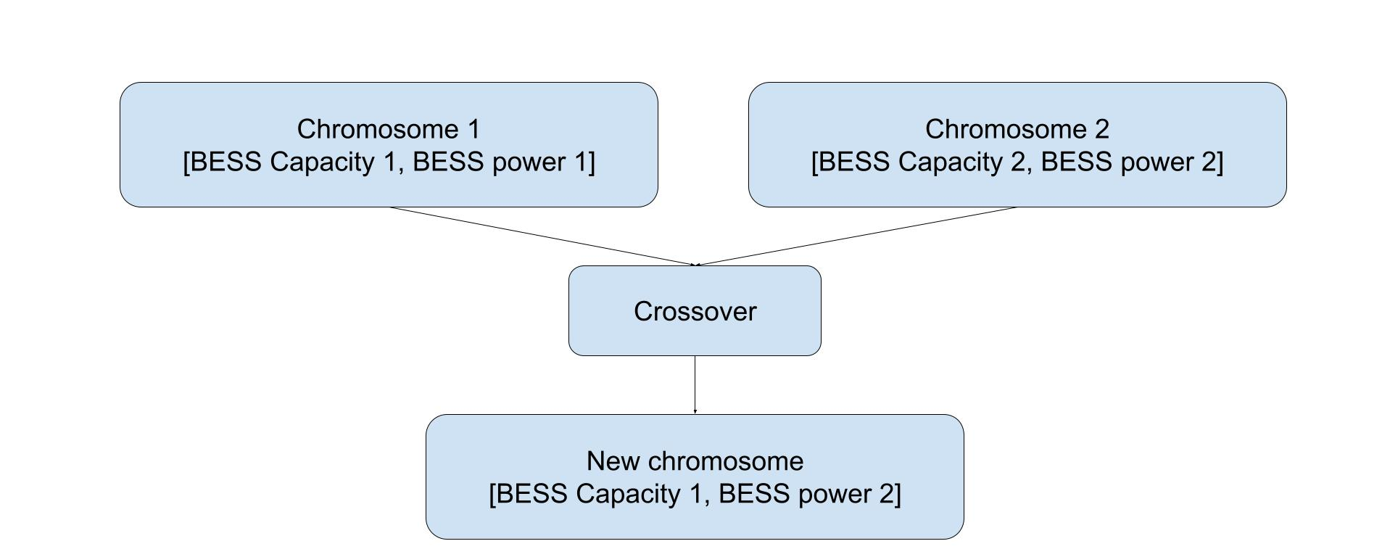
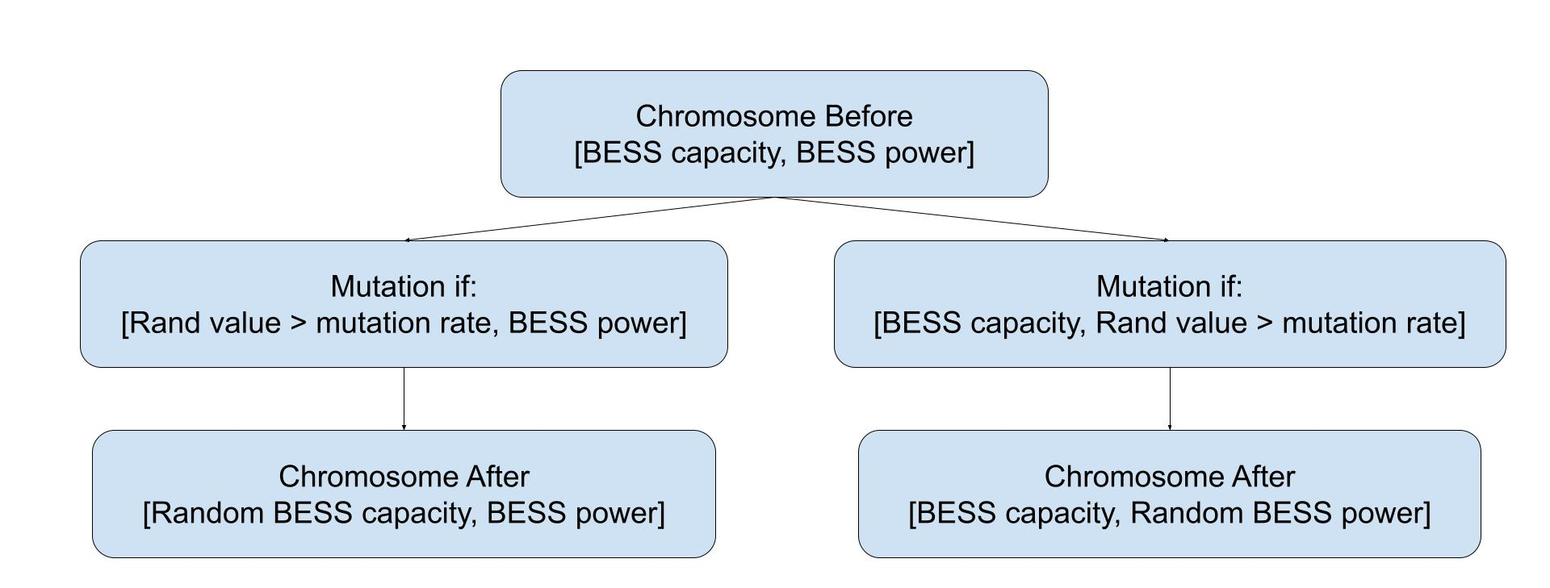
Genetic algorithm
Based on evolution
Solutions contains genes
Genes = [BESS capacity, Power]
Objective function -> fitness value
Parent selection
Crossover
Mutation
Notes:
Rank selection of parents: ranks the solutions and picks the best ones after that. Assures it to always get the best solutions. Takes 50% of solution as parents, the rest becomes filled with new random solutions
Crossover creating new solutions from combining two parents: uniform: Gets from a uniform distribution random values to pick form one of the parents for each of the genes inside of the .
Mutation: at low chanes mutation is applied to a solution and then the genes are changed by random.
Move crossover and mutation figures to after last slide?
Smaller blue boxes

Slide 16
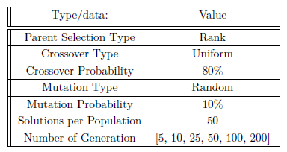
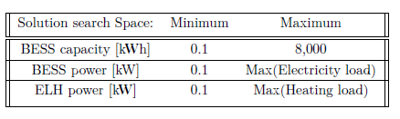
Genetic algorithm - parameters
Generations = number of iterations
50% of solutions are used as parents – The remainder is filled with new random solutions
Notes:
WRank selection of parents: ranks the solutions and picks the best ones after that. Assures it to always get the best solutions. Takes 50% of solution as parents, the rest becomes filled with new random solutions
Crossover creating new solutions from combinding two parents: unifrom: Gets from a unifrom distribution random values to pick form one of the parents for each of the genes.
Mutation: at low chanes mutation is applied to a solution and then the genes are changed by random.
Not go into detail can go more into this if there is question. Already explain what GA is
Say why Crossover prob is higher than mutation prob. Used in literature etc

Slide 17
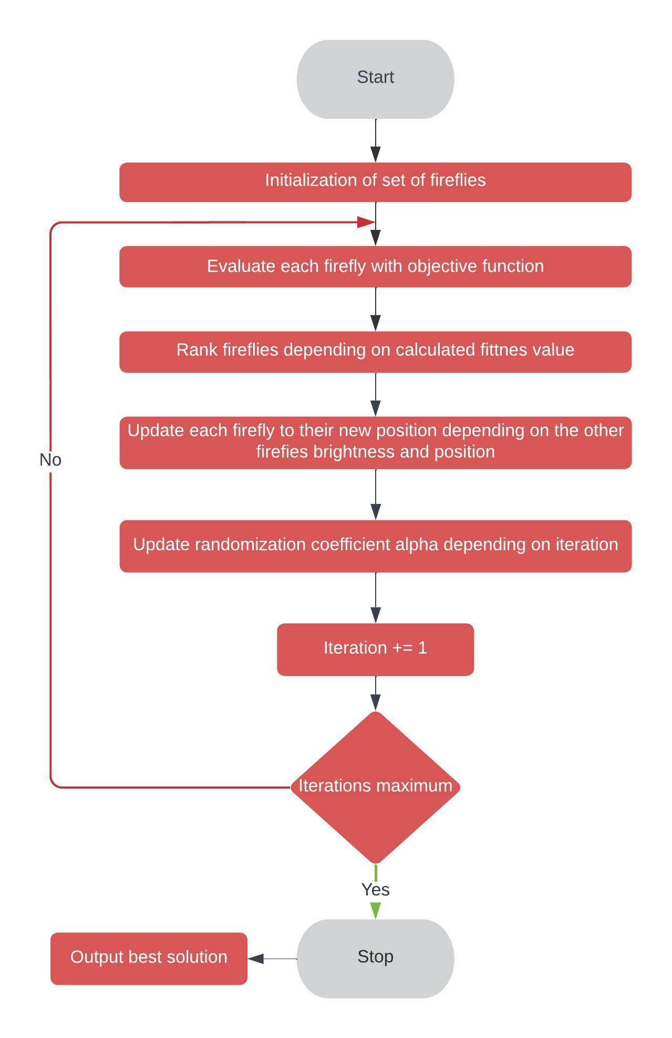
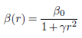
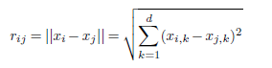
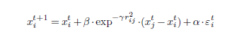
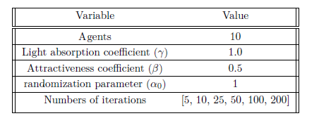
Firefly algorithm
Attractiveness parameter
Cartesian distance
Based on fireflies and their attractiveness to each other
A firefly represent a solution
The brighter the firefly the more attractive
Fireflies moves towards the most attractive (best solution) fireflies
Search space same as for GA
Equation of movement of firefly
Notes:
Animation go through quickly the equations step by step
Explain how it works quickly, fireflies moves to the birghtess one etc

Slide 18
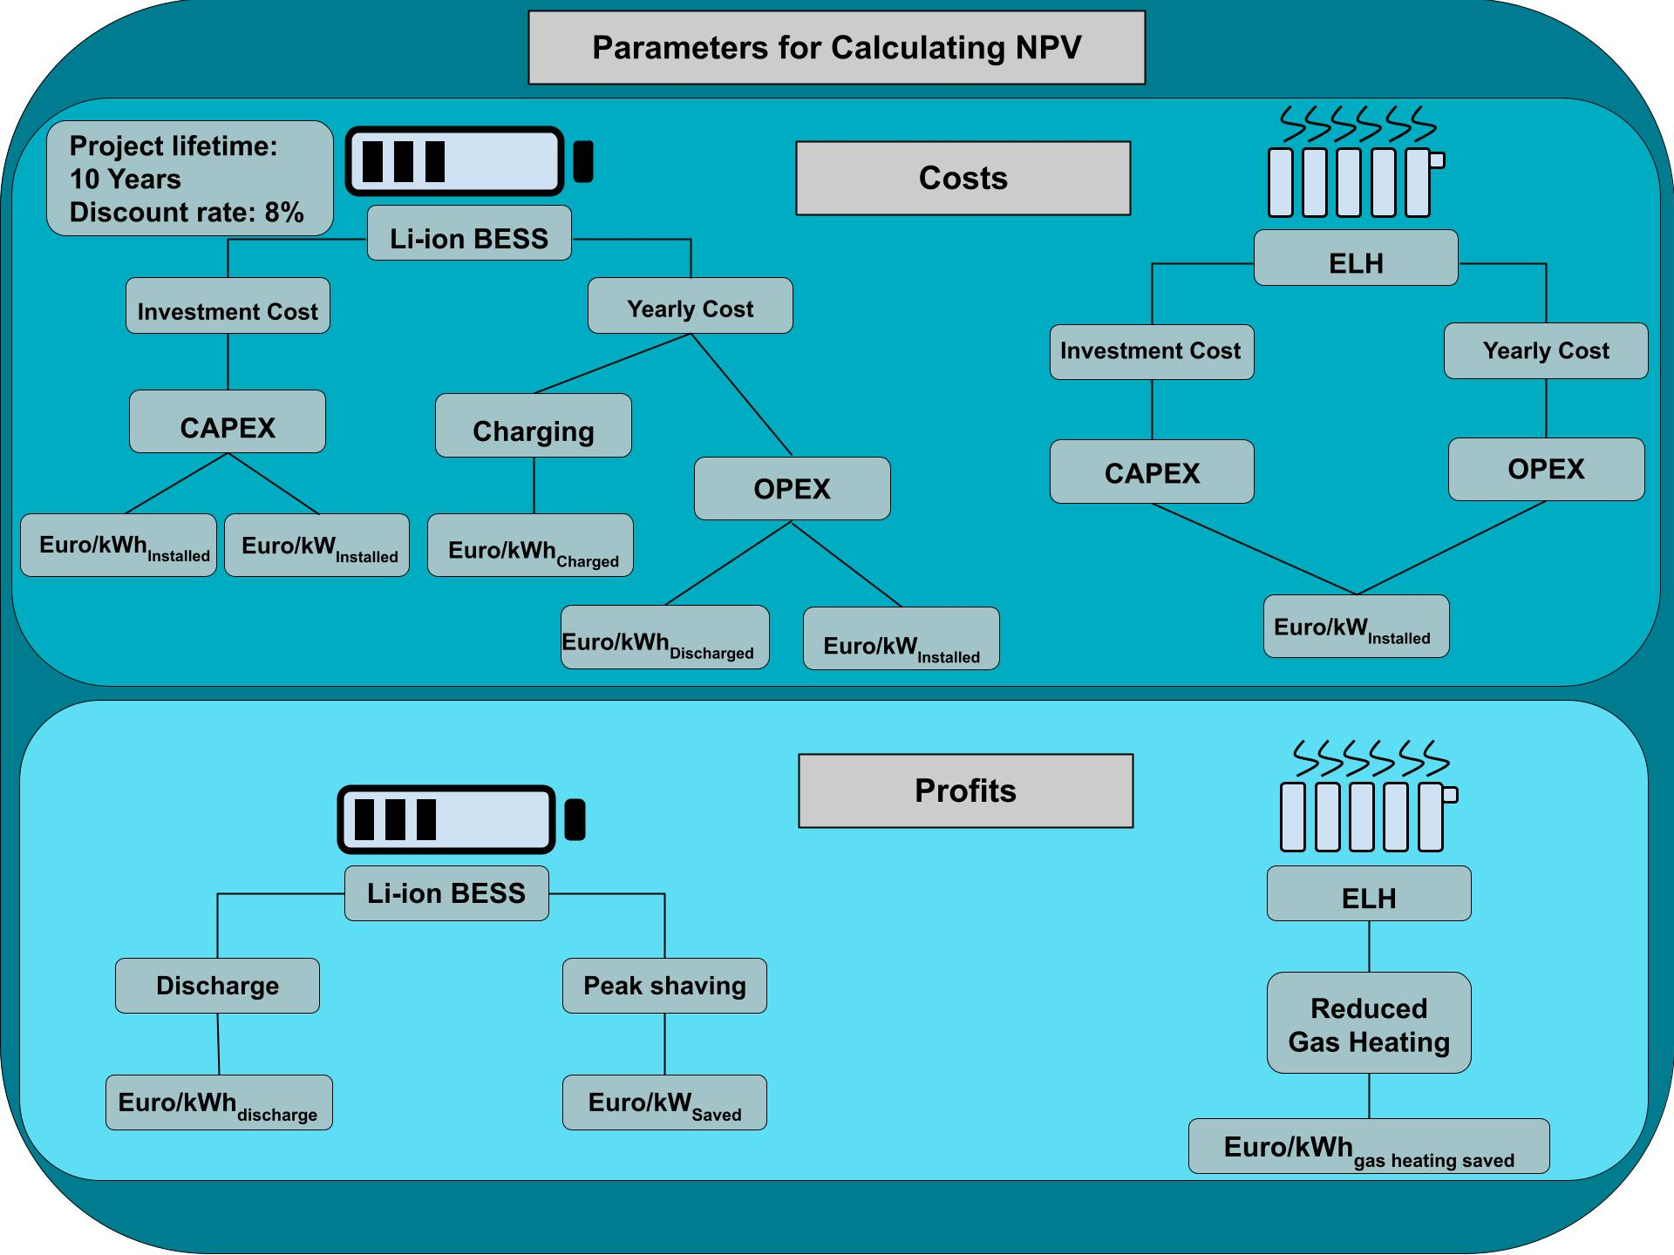
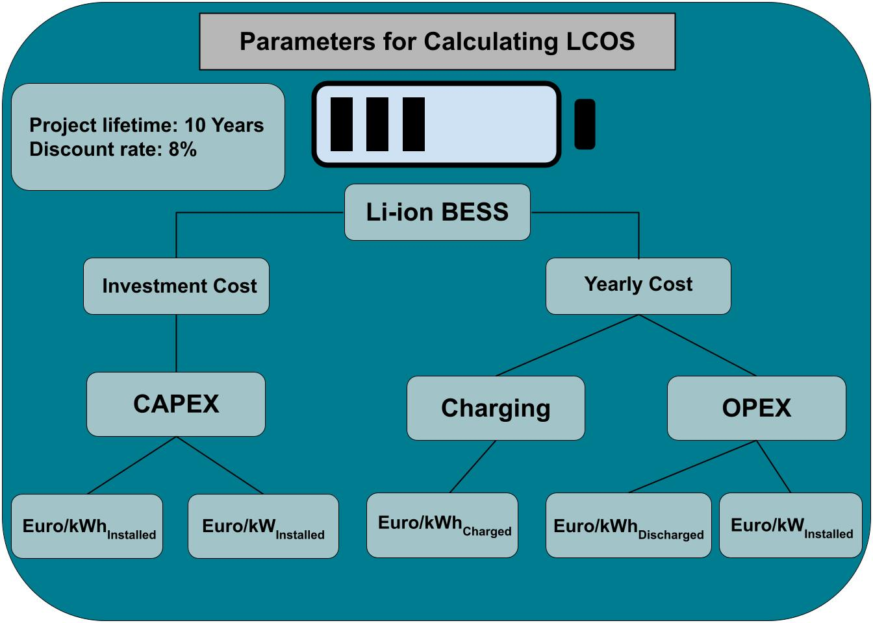
Case study
Notes:
Move to end of presentaion

Slide 19
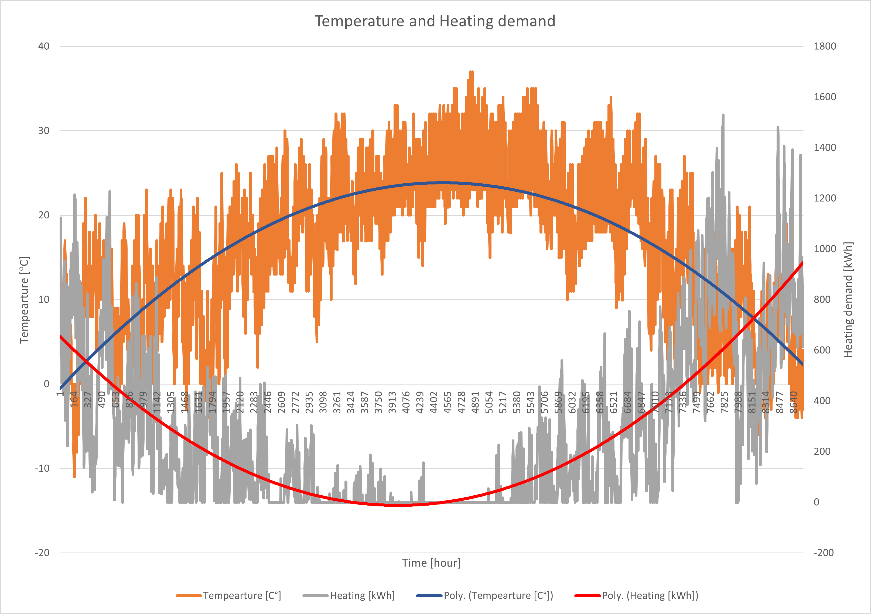
Data used in optimization
All monetary values are changed to 2022 euro, before optimization takes place
BESS linear capacity degradation of 1.6% each year resulting in 15% after 10 years.
Day ahead electricity cost from Nordpool 2017 Stockholm
Temperature, electricity and heating demand from residential building in Theran, Iran, 2017.
Yearly consumption:
Electricity: 3.45 TWh
Heating: 2.3 TWh
Notes:
Combining of data is not what is of importance that they are not from same places, importance is to see how effective the the algorithms are. The data is real world data which is better then creating an own data set.
One line sentence that explains the data used

Slide 20
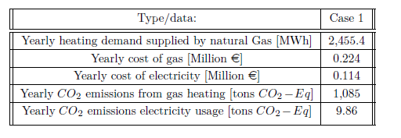
Result - Case 1
Base case
In order to compare with Case 3 on savings from switching to an ELH from gas heating
Notes:
Include that this is baseline for the case including no installment

Slide 21
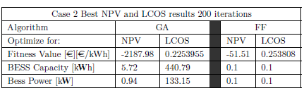
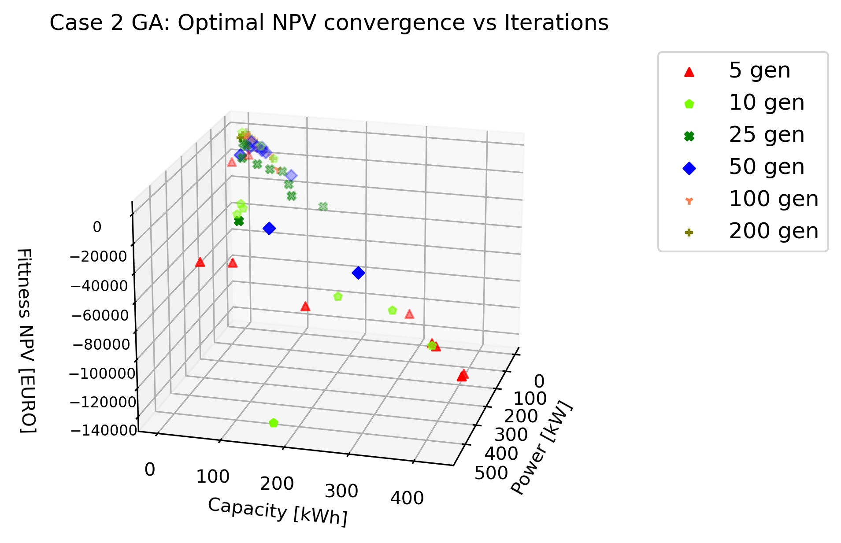
Case 2 – results
Neither GA or FF can get positive NPV
FF finds bets NPV value at lowest value in search space. I.E., not worth investing in BESS
GA can find better solution for LCOS with high values for BESS capacity and power
GA and FF shows convergence of solution with higher iterations
Notes:
Write that this case implementes the battery energy storage
Implemnt pictures of all convergence in the end for appendix

Slide 22
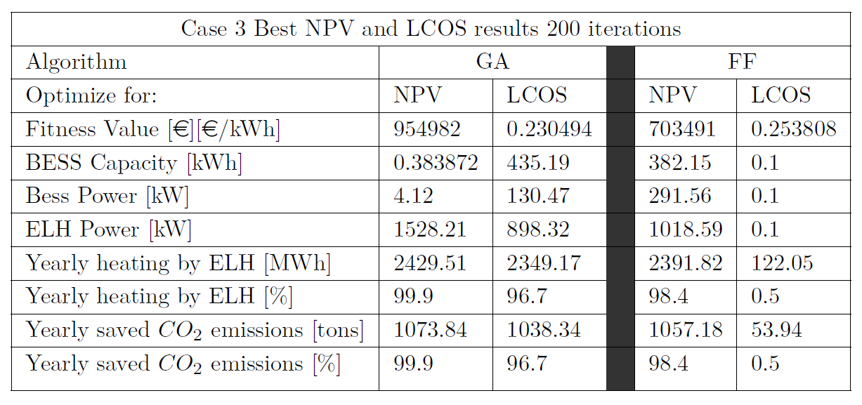
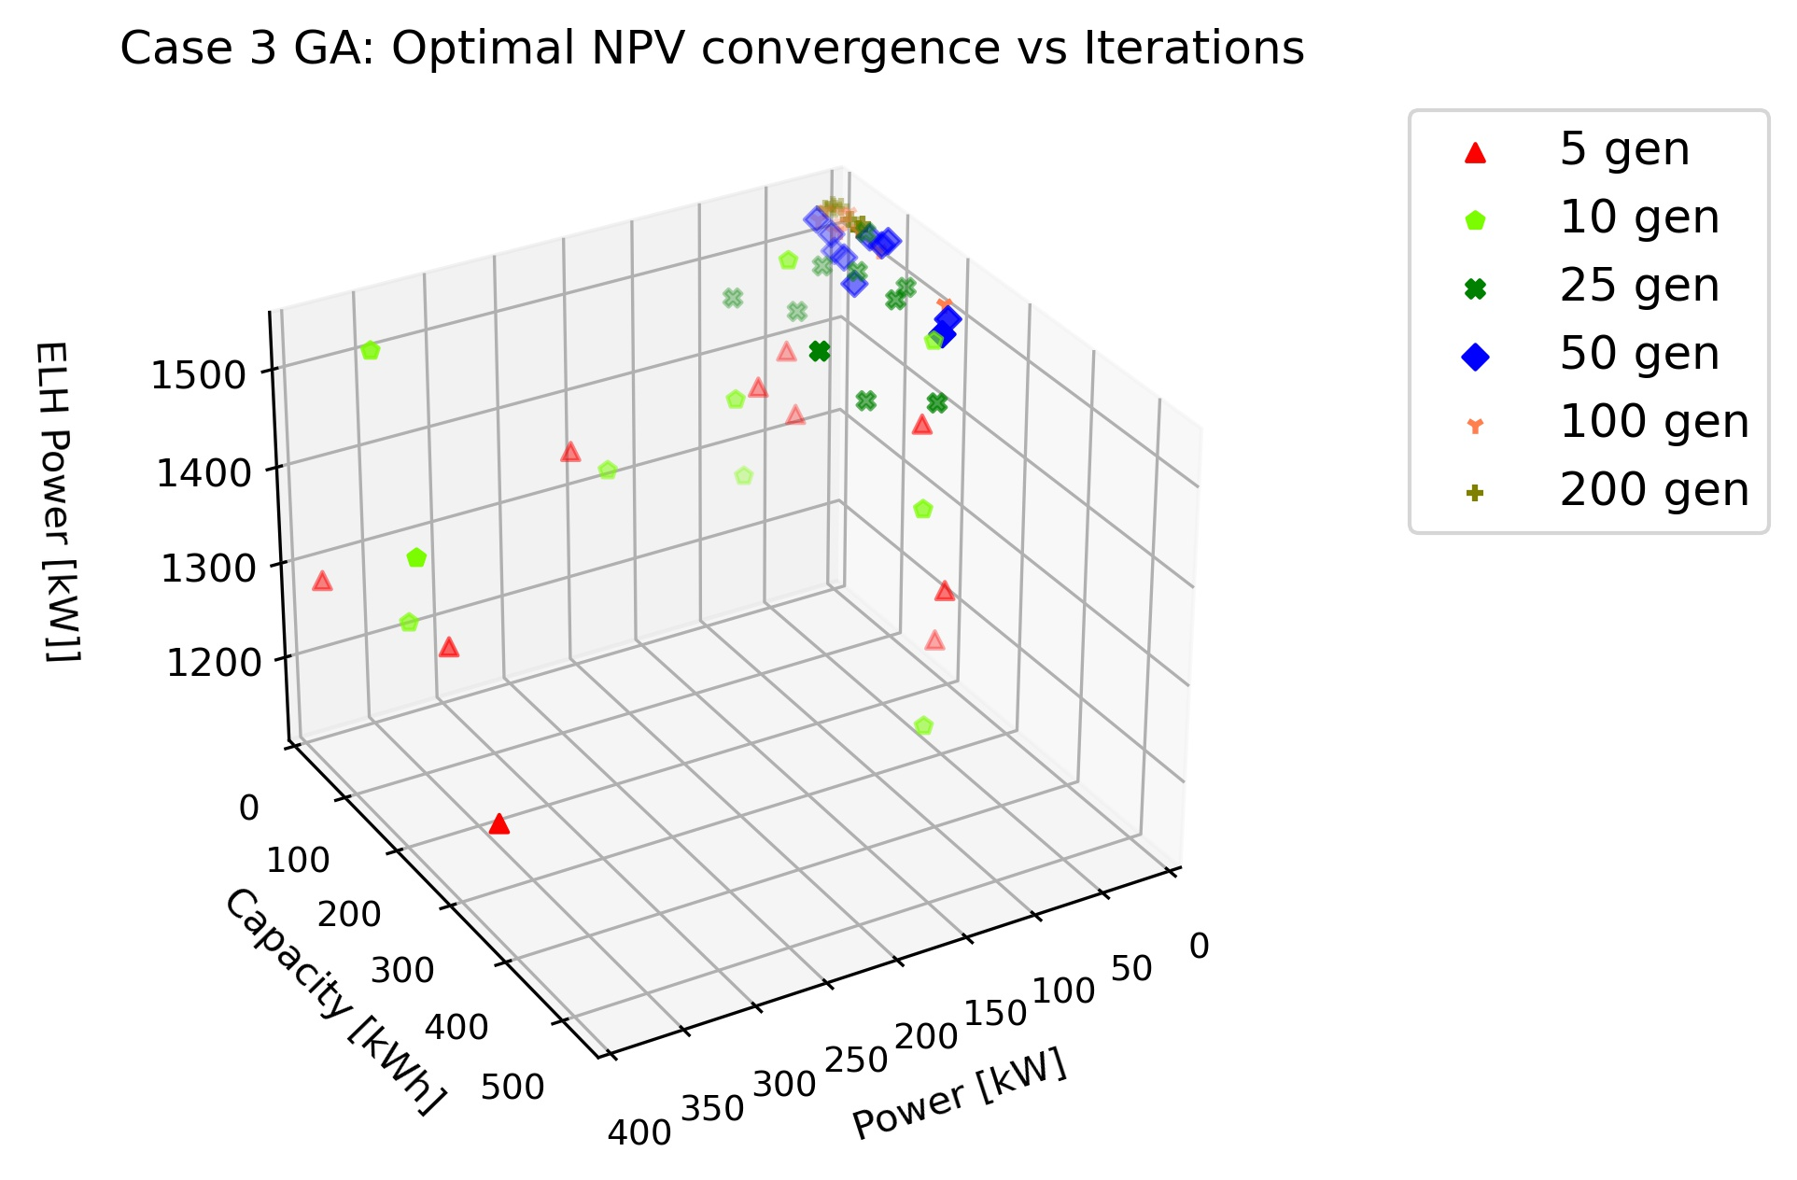
Case 3 – results
GA finds better results for both LCOS and NPV
GA converges with higher iterations
FF gets stuck at local optimum at [0.1, 0.1, 0.1] for LCOS optimization
NPV vs LCOS gives highly different solutions
GA wants to maximize the ELH power
Large part of yearly heating can be supplied by ELH at lower power then max.

Slide 23
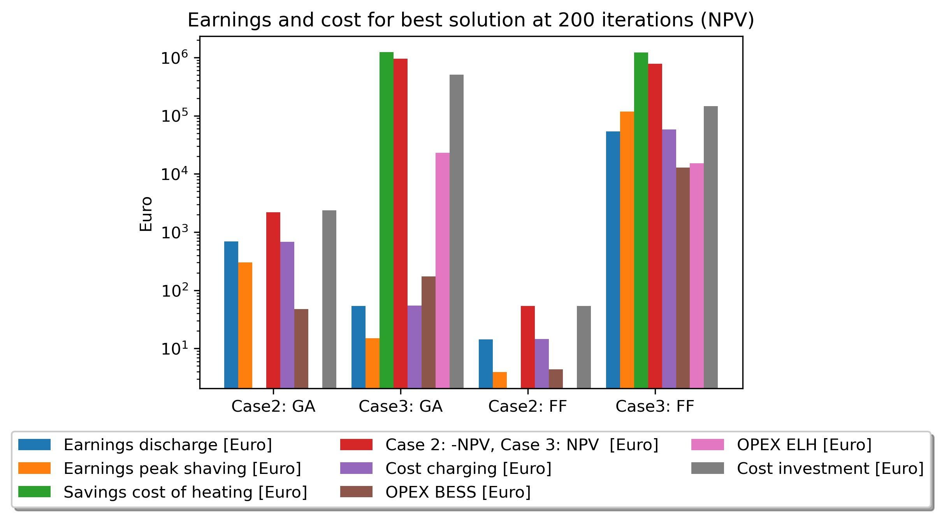
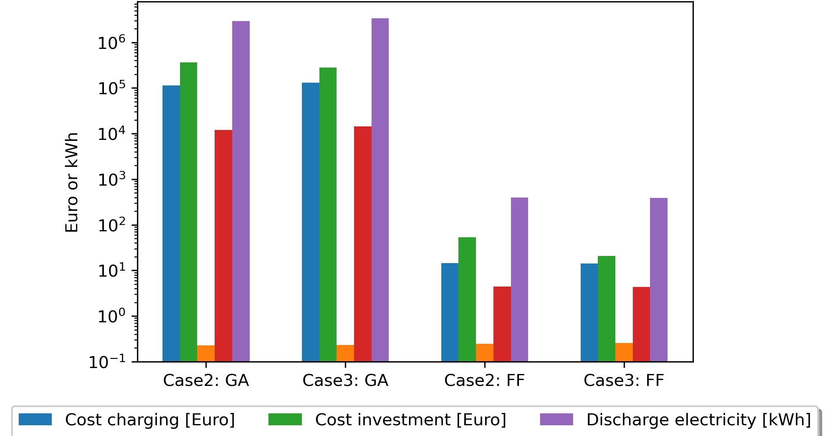
Breakdown of cost/earnings
Case 2 and 3: Energy arbitrage not worth it
Saved heating cost due to ELH stands for significant amount of earnings
Investment cost stands for a big part of investment, for both LCOS and NPV
Notes:
Show that energy arbritage is not worth it.
Most comes from peak shaving in case 2
Case 3 elh leading to savings in gas cost is the main contributor, the cost of running the elh is included in that value. So it is an straight profit
NPV is negative for case 2 NPV
Line to show total resulting
Stack bar of earnings and one for cost!

Slide 24
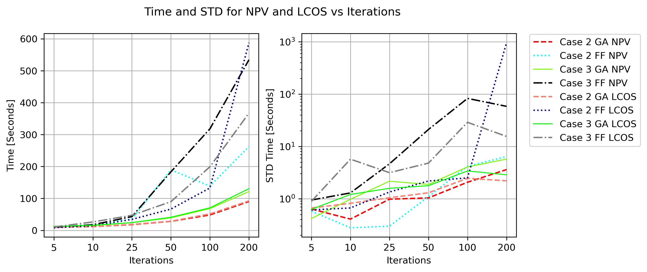
optimization time
GA is faster in all cases
The STD of time is increasing with number of iterations
FF shows a steeper increase of STD in time with higher iterations – showing its more complex inner workings.

Slide 25
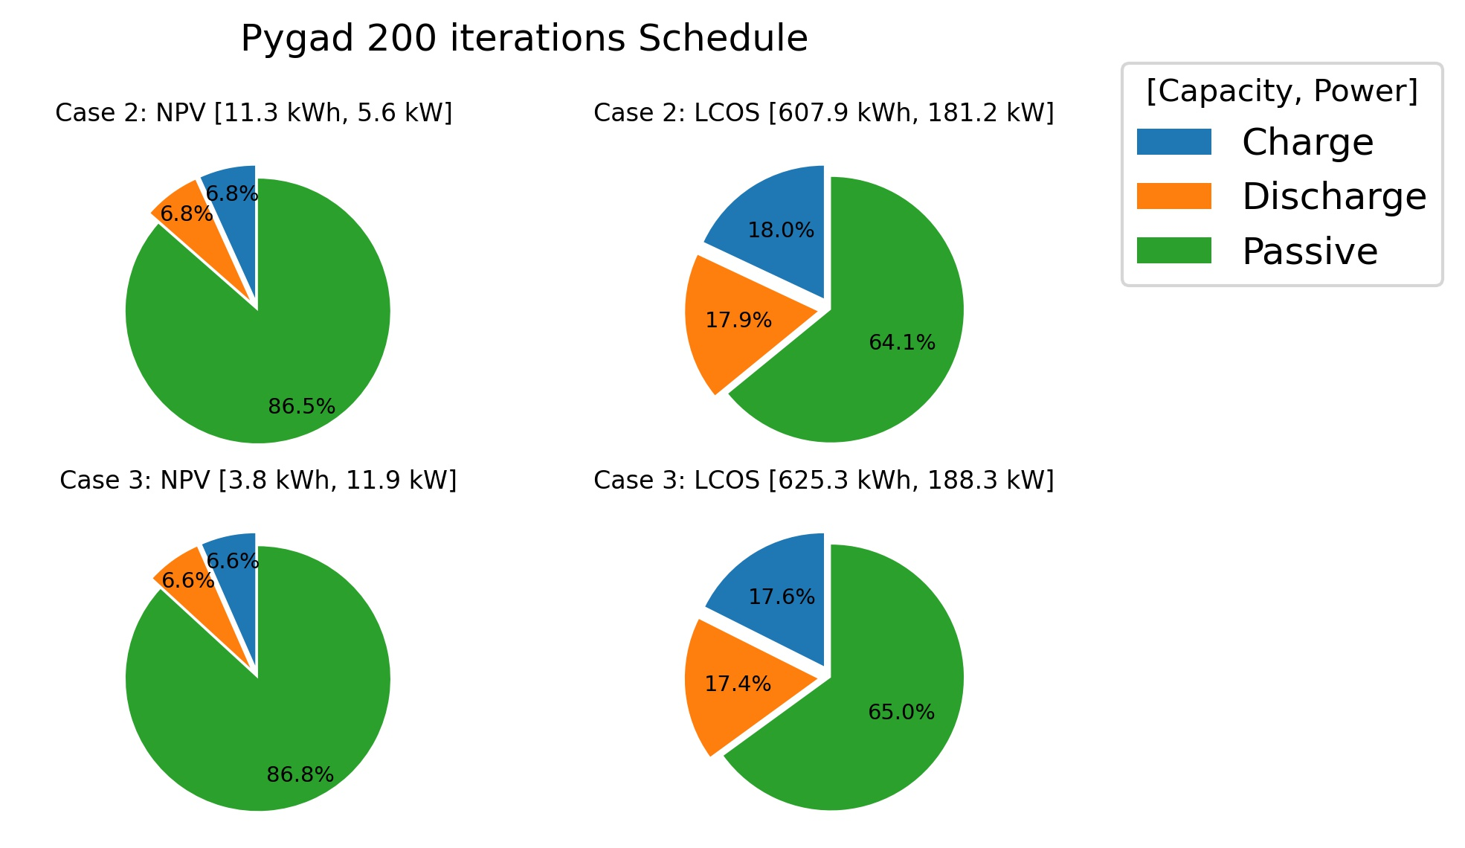
Results - Schedule function
Only uses BESS a low amount during lifetime
NPV: 14%
LCOS: 36%

Slide 26
Discussion
LCOS result (GA) from case 2 and 3: 0.2256 €/kWh and 0.2308 €/kWh
Compared to real world values¹: LCOS of 0.185 – 0.2704 €/kWh for Li-ion batteries
Similar results -> GA and model can be seen as a useful tool to optimize for LCOS
Negative NPV for Case 2
Positive NPV for Case 3, due to installment of ELH
Schedule function using simple methodology –> not optimized usage of BESS
Only optimized for Energy arbitrage and not Peak shaving
Widely different solutions when optimizing for NPV or LCOS
1. Lazard, Levelized Cost of Energy and Levelized Cost of Storage 2018. en. 2018.
Notes:
Intereparability of using ELH and the storage
Schedule function, -> not optimal usage of BESS
This study only optimized for energy arbtirgae, but peak shaving is a big part.

Slide 27
Conclusion
For case 2 investing for positive NPV not possible
GA is faster and provides better results -> suitable algorithm for stated problem
Nearly all profit in case 3 stems from savings by using ELH instead of heating using gas
FF gets stuck in local optimums -> not as useful as GA
Notes:
Meta heruistic algorithms can be used for optimal sizing of energy storage
GA is faster and get more useful results than FF
More research should be implented for optimal dispatch.
Focus on the algorithms and their use case etc

Slide 28
Future work
Investigate other BESS charge/discharge schedule functions and its effect on the results
Apply Meta-Heuristic algorithms to the problem regarding optimal scheduling.
Optimize for CO₂ savings from ELH instead of NPV or LCOS.

Slide 29
Thanks for listening
Any questions?

Slide 30
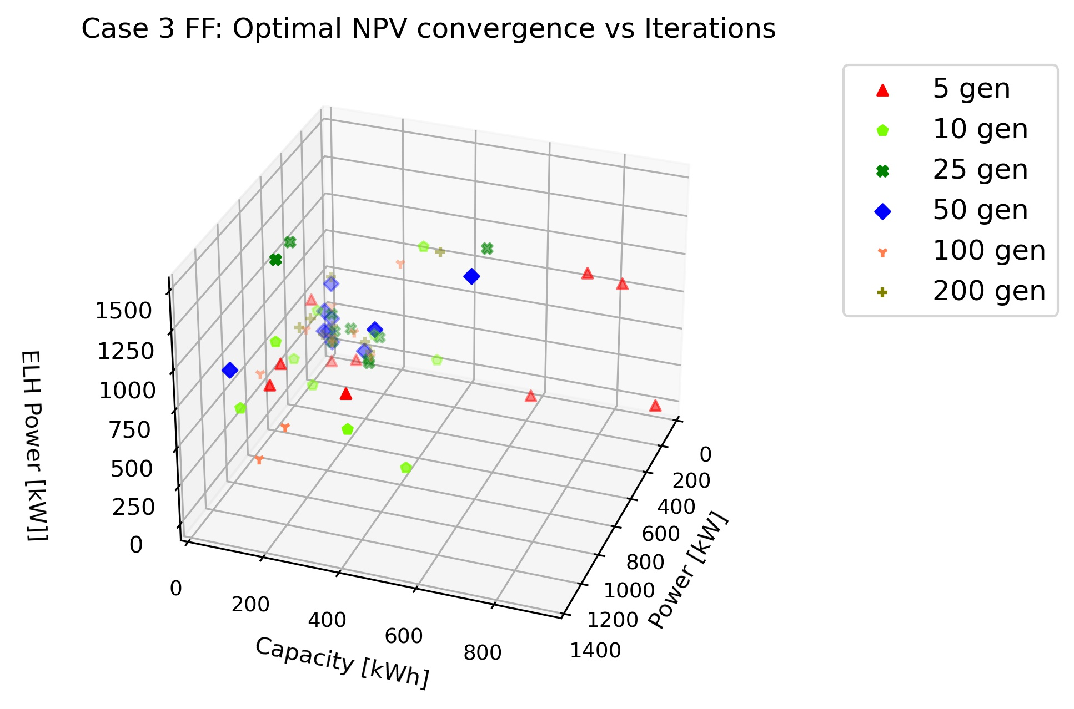
FF Convergence/ Limitations
Limitations
Other Meta-Heuristic algorithms could have been used
Different Energy storage techniques could have been tested (Thermal, Hydrogen)
Step size in optimization (1 hour)

Slide 31
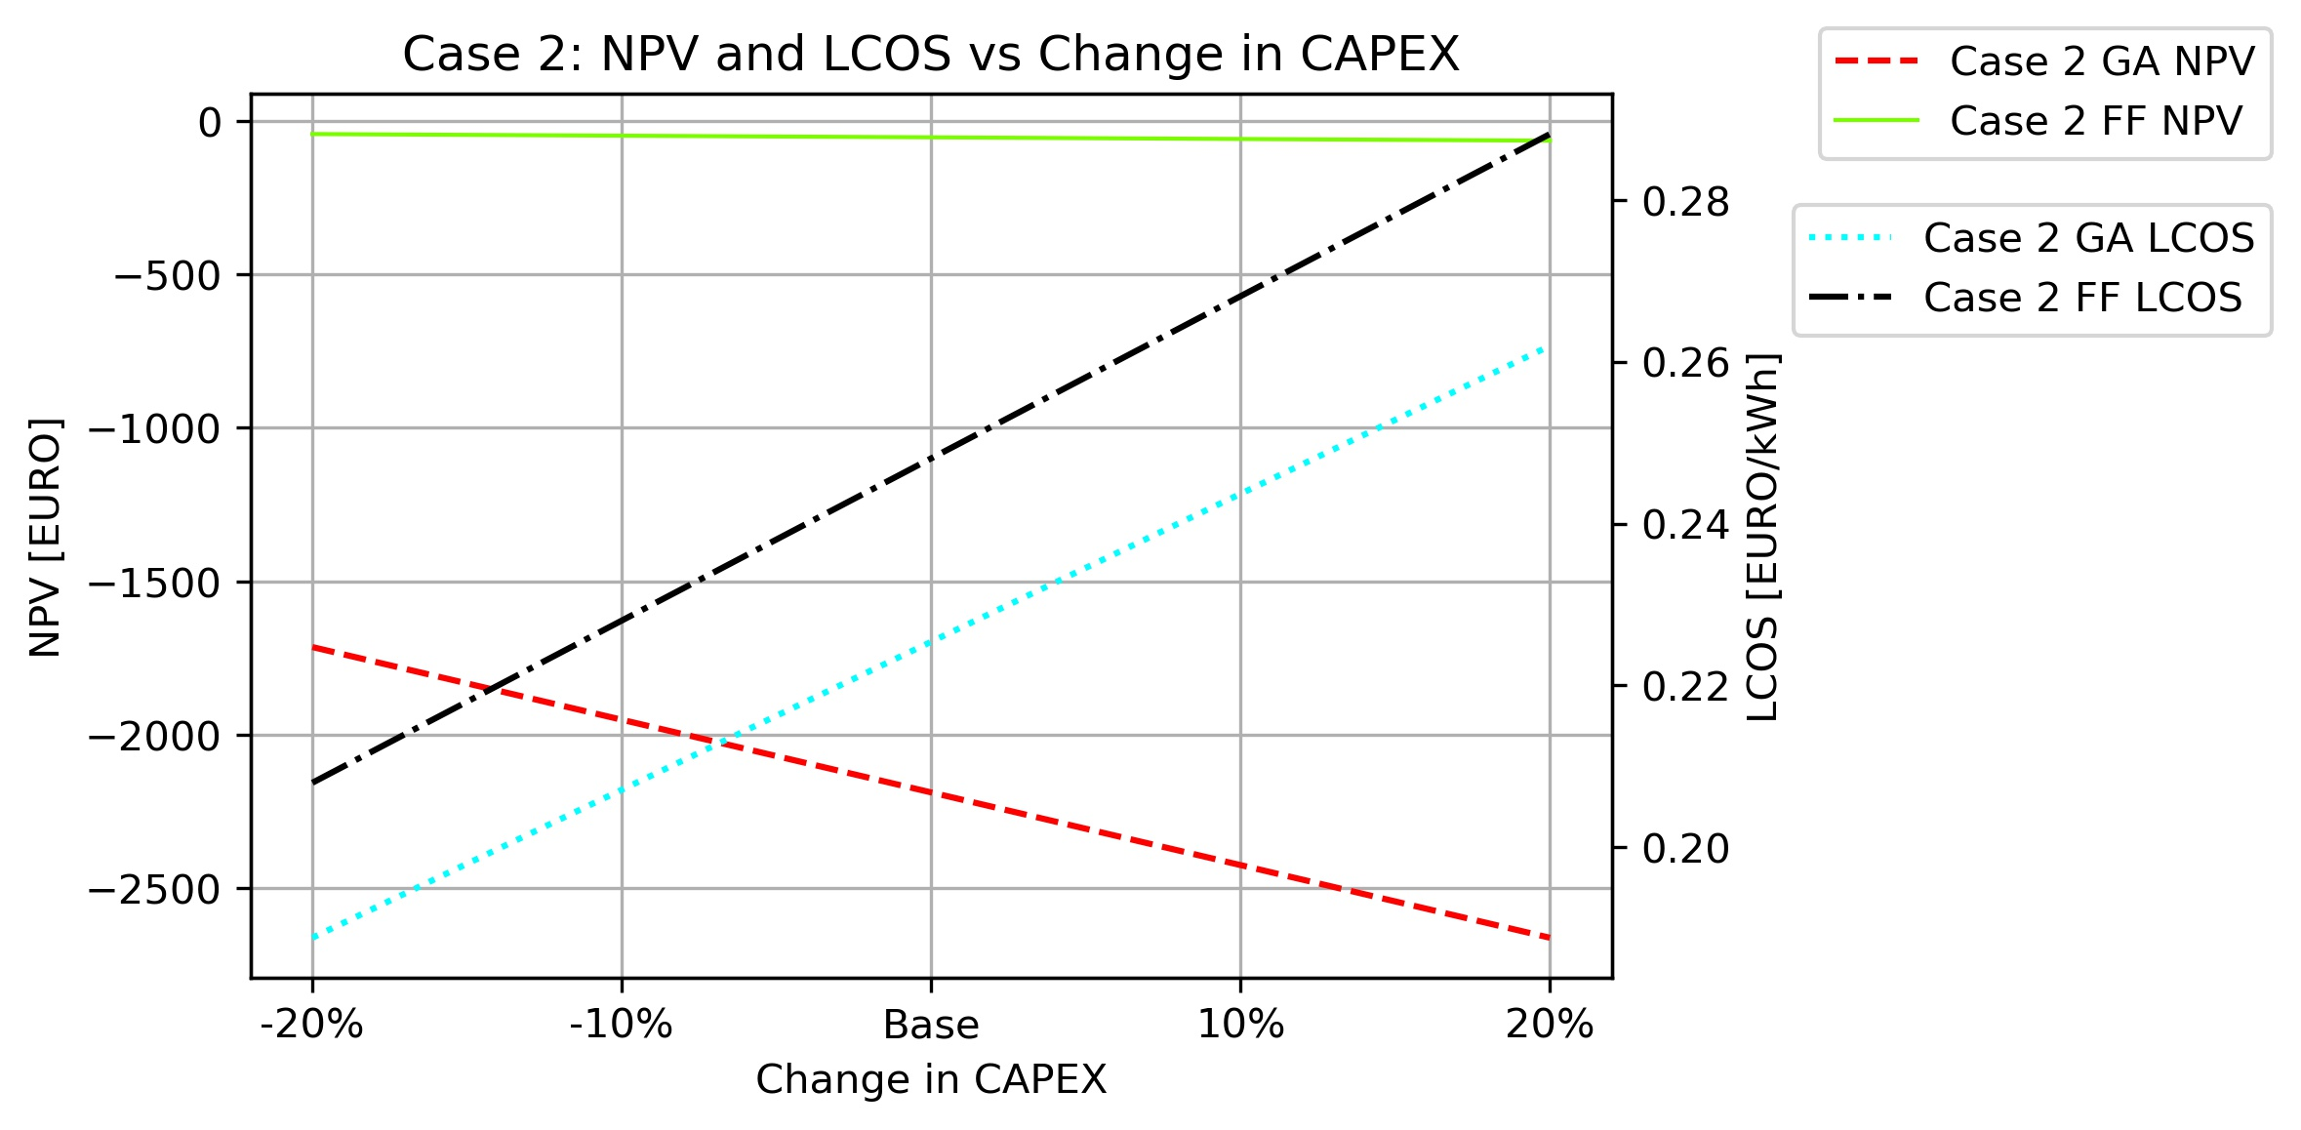
Sensitivity analysis
NPV and LCOS dependence on CAPEX
Linear change in CAPEX leads to linear change in NPV and LCOS

